Slide 1
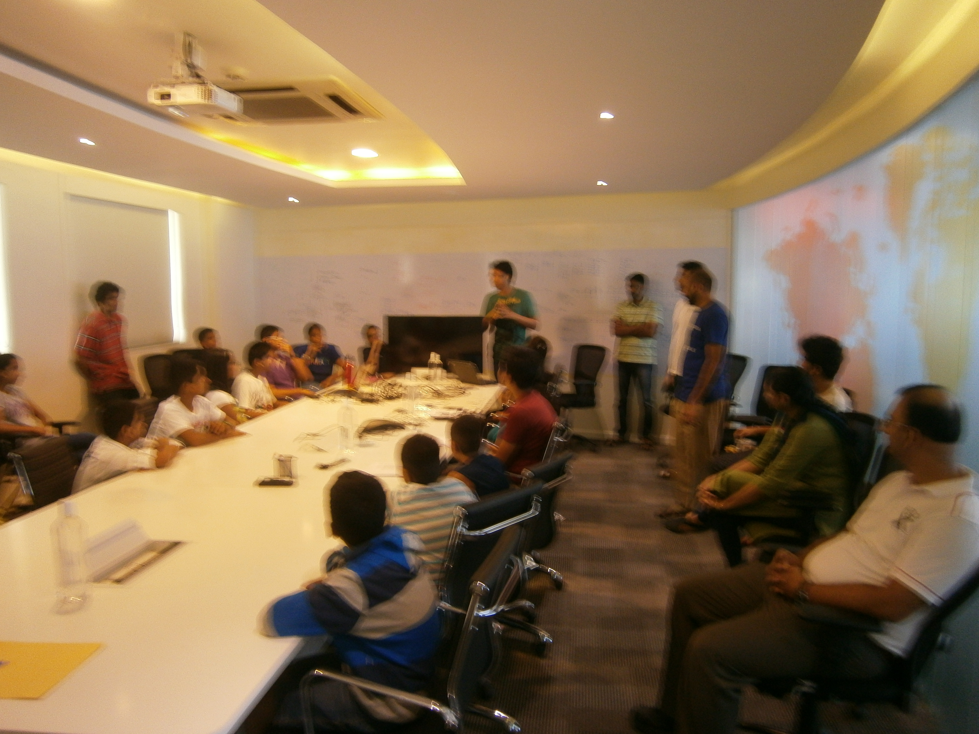

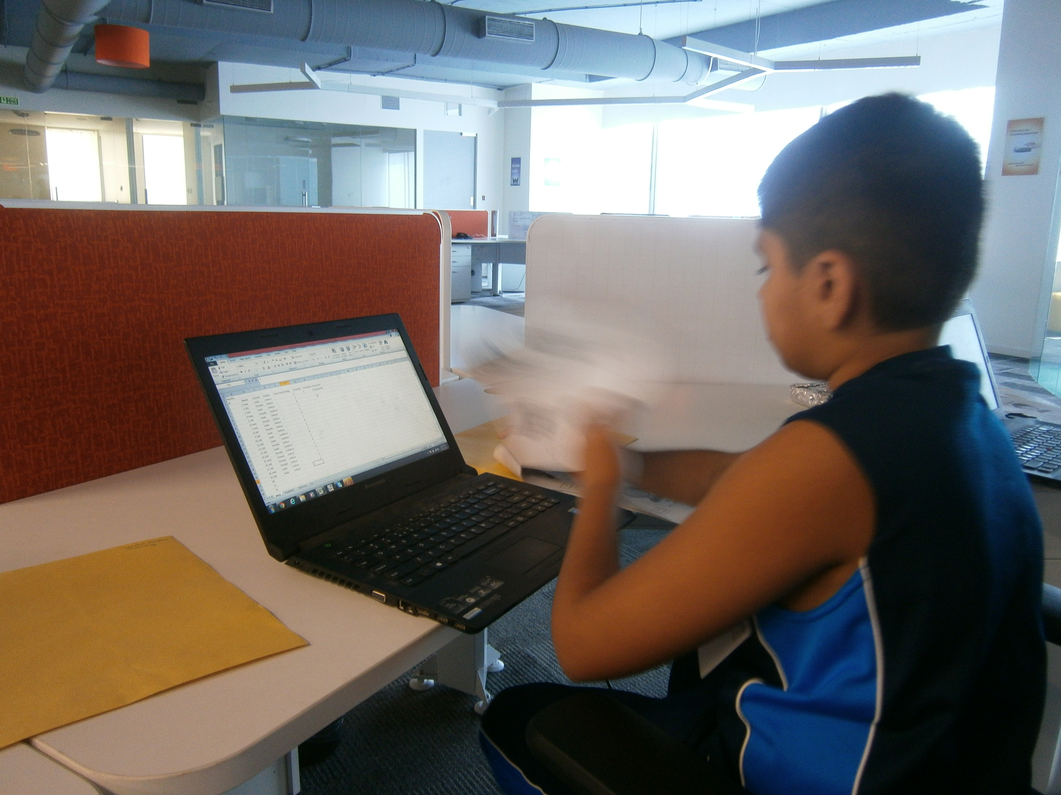
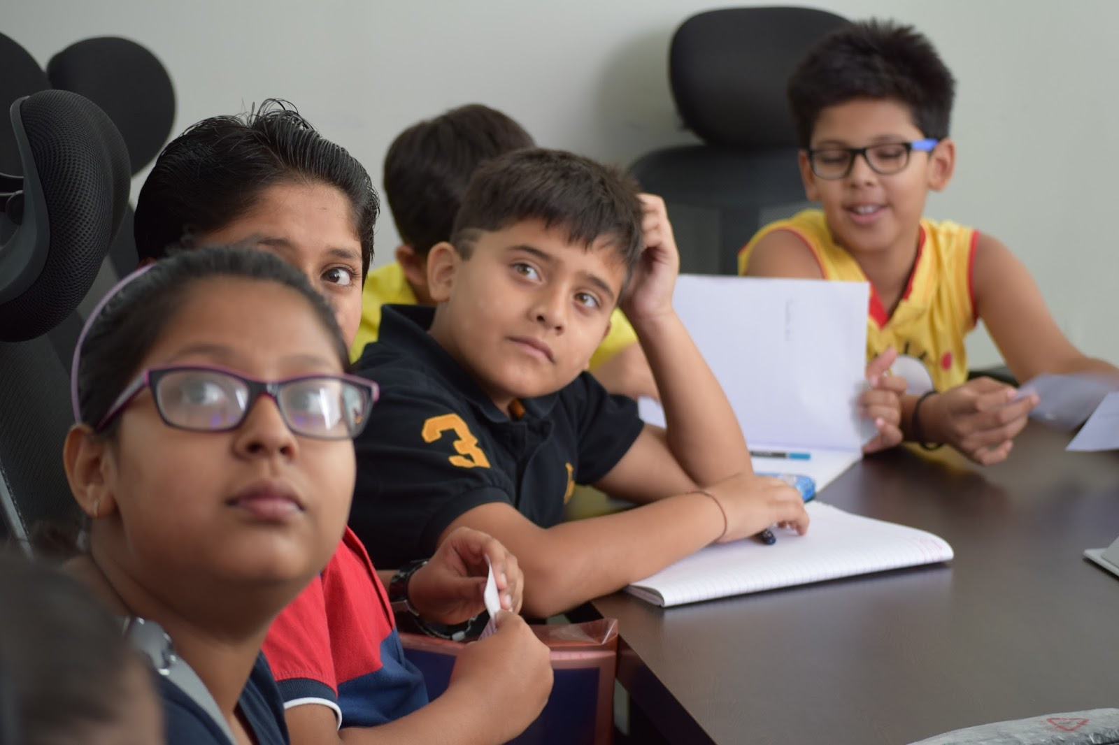
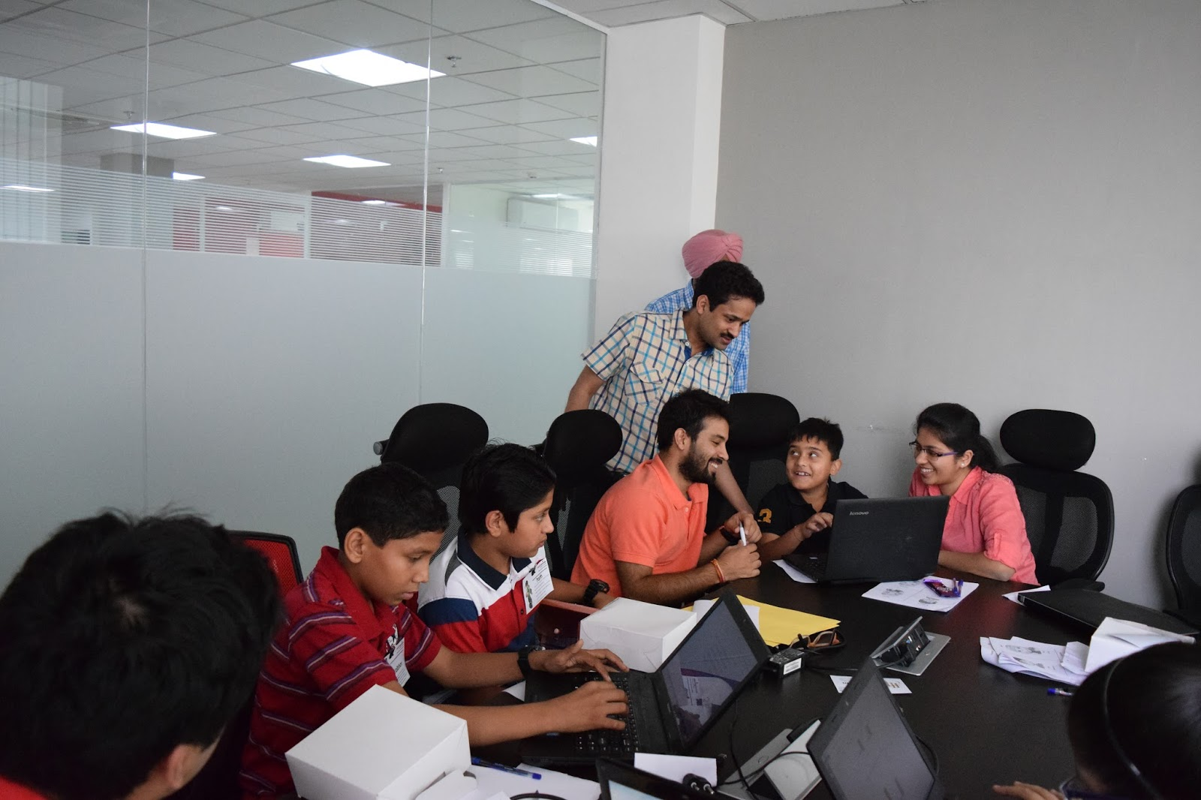
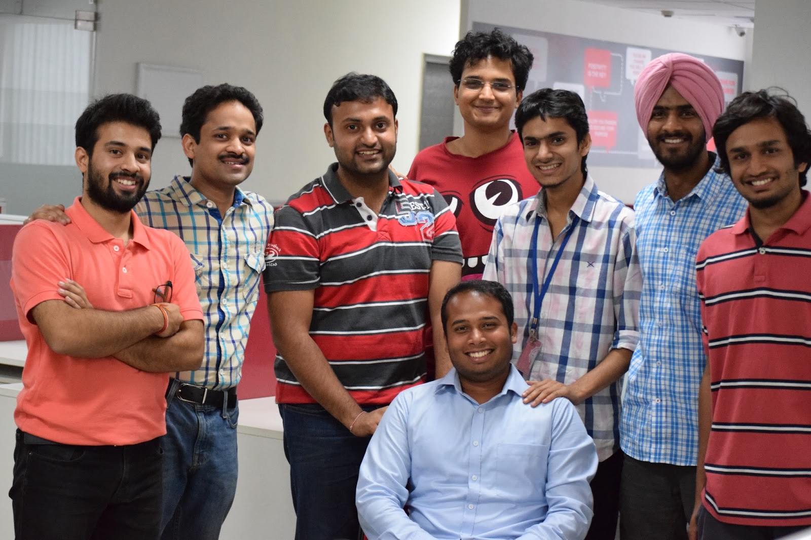

Data science for kids!
Shashank Srikant Varun Aggarwal
And other members from Aspiring Minds Research who made this a success

Slide 2

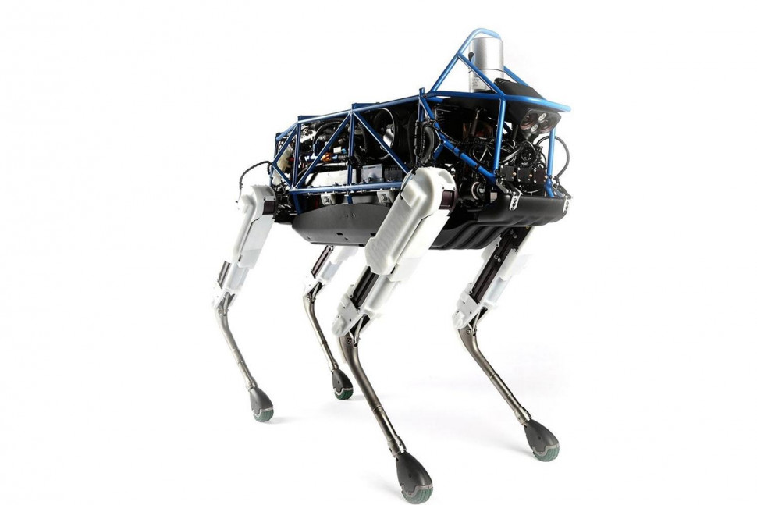


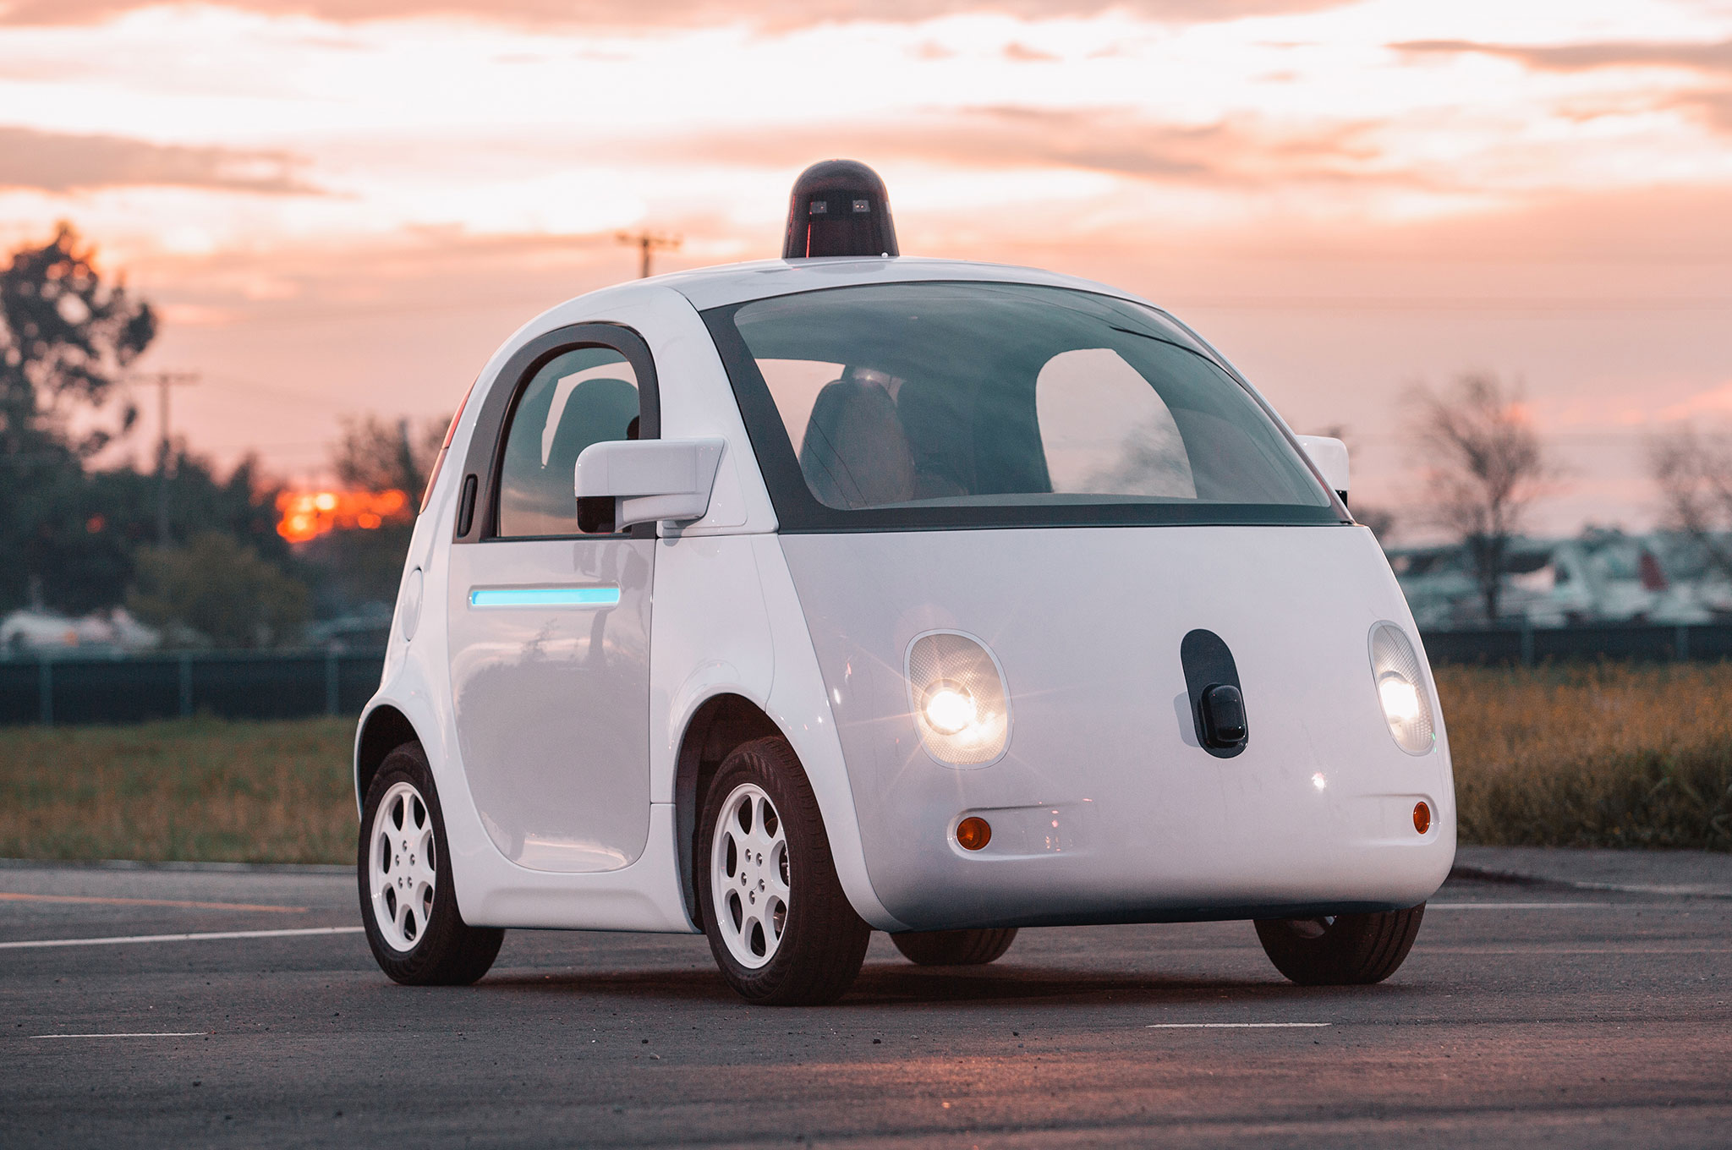






Data science
Interesting applications
Voted the sexiest job of the 21st century
Among the highest paying job profiles today
$50B industry

Slide 3

Data science
50% gap in the supply of data scientists versus demand

Slide 4

Data science
50% gap in the supply of data scientists versus demand
Market reaction
Being introduced in undergraduate courses
Specialized graduate-level courses and doctoral programs
Lots of online material and sandboxes for learning and practice

Slide 5
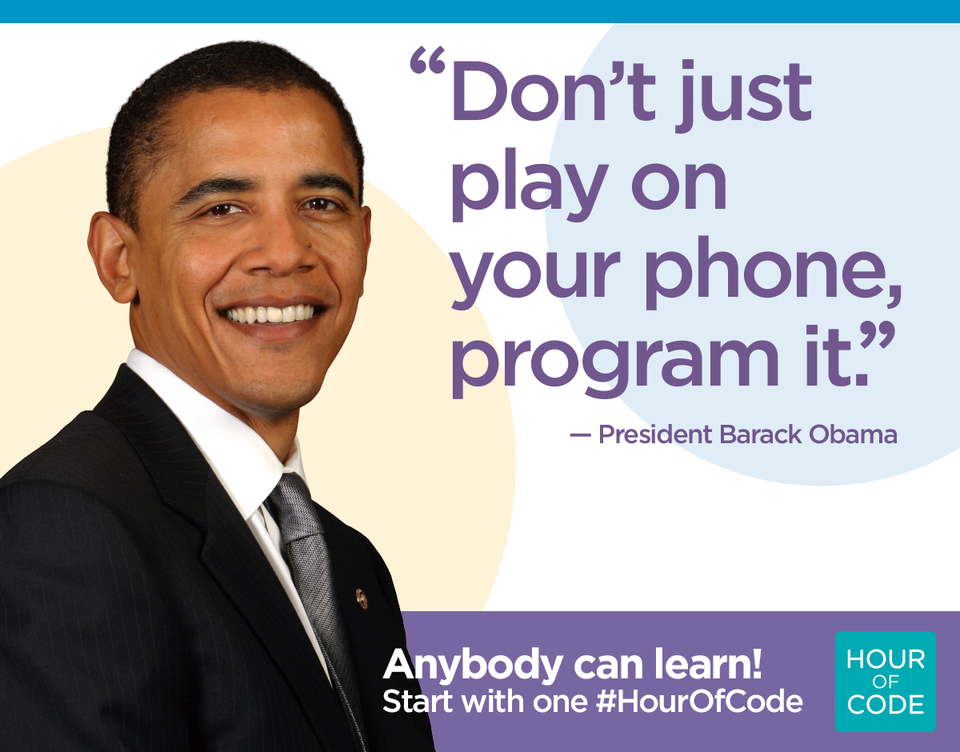

But what about school curricula?
We have realized the importance of writing code
Increasing outreach effort at the high school level

Slide 6
But what about school curricula?
We have realized the importance of writing code
Increasing outreach effort at the high school level
What about data science?

Slide 7
Our aim
Develop a framework to teach the foundations of data science to a school audience
Lay out the design principles for such a curriculum
Ensure that it is pedagogically experiential learning and problem-based learning than being simply lecture content plans
Demonstrate its utility by implementing it
Keep the material very accessible. Make it easy for the community to replicate.

Slide 8
What is data science?
Collect data of things that have happened
Study it
New information!

Slide 9
Predictive data science
Supervised learning
Unsupervisedlearning

Slide 10
Predictive data science
We know what we want to predict
We have concrete values of some outputs. We then see what can signal such values
Supervised learning
input: What we believe helps predict the desired output
output: What we want to predict
We’re trying to learn a function f such that f(input) = output
Notes:
<<There’s a running example here>>

Slide 11
Predictive data science
Age
Sport
….
Height
Is sick?
S1
5 years
football
160 cm
Yes
S2
15 years
baseball
164 cm
No
….
S3
15 years
football
128 cm
No
S4
5 years
swimming
149 cm
Yes
Notes:
<<There’s a running example here>>

Slide 12
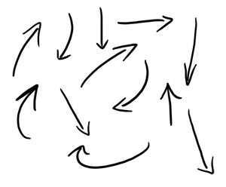
Predictive data science
f(
) =
Age
Sport
….
Height
Is sick?
) + .. =
a(
) + b(
Age
Sport
Is sick?
Notes:
<<There’s a running example here>>

Slide 13
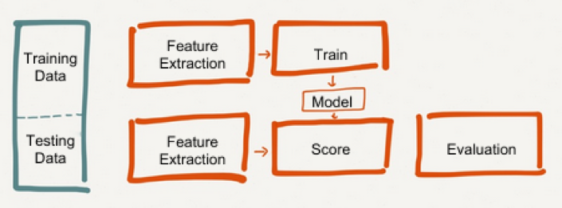
Overview – Supervised learning

Slide 14

Our aim

Slide 15
The exercise that we designed

Slide 16

We get them to build a friend predictor
Can we predict whom you will befriend based on friends you’ve just made?

Slide 17
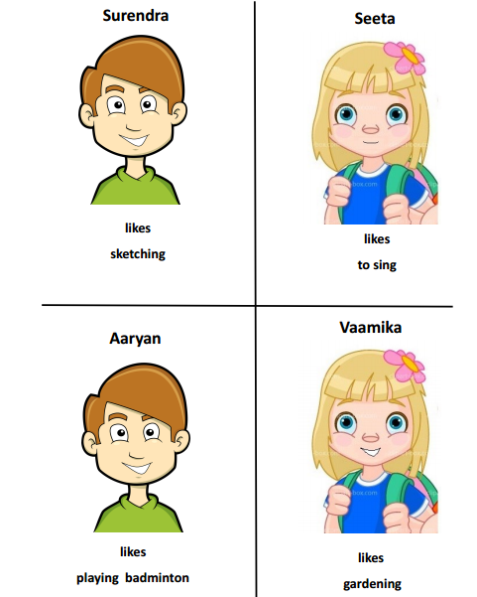
Students tell us whether they would befriend kids we show them on flash cards
They first rate a bunch of flash cards
These are kids with their names and hobbies described
Students grade them on a scale of 1-5: 1 – least likely to befriend
56 such samples rated

Slide 18

We then discuss possible features
Name
Kathy
Gender
Others?
Hobby
likes
playing musical instruments

Slide 19
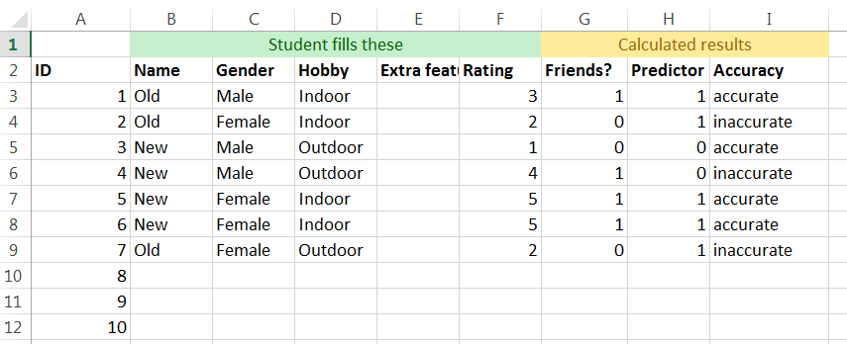
Get them to add this information on a spreadsheet

Slide 20
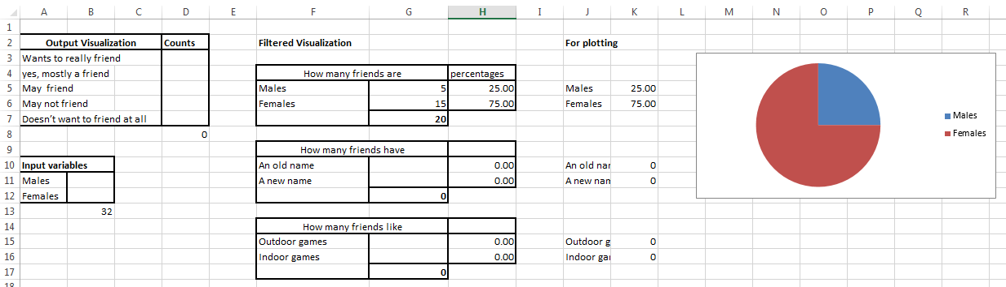
Visualize this information

Slide 21
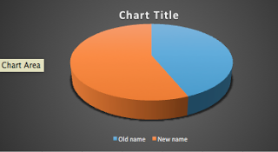
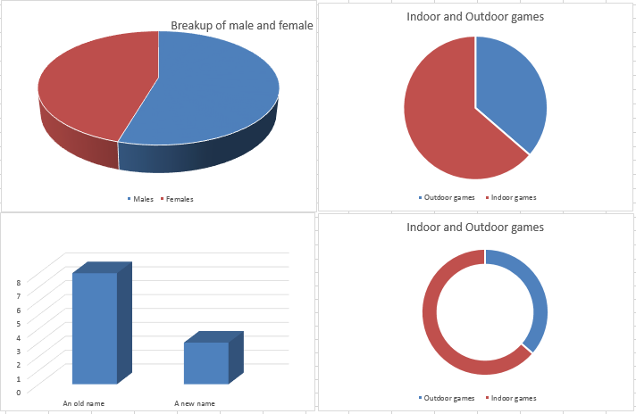
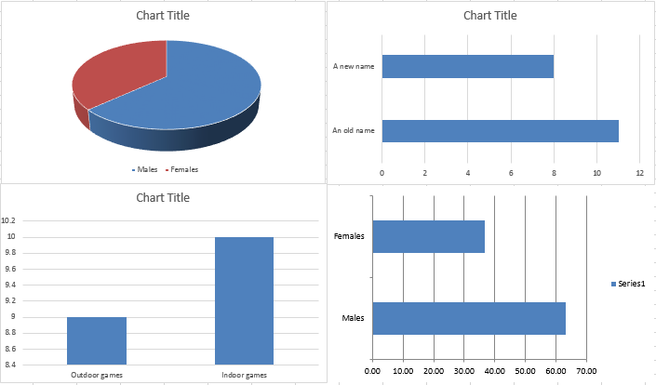
Visualize this information

Slide 22
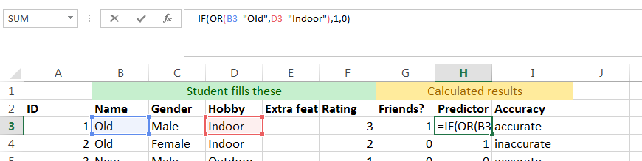
Build a predictor
Use a simple IF-clause and a combination of AND, OR conditions

Slide 23
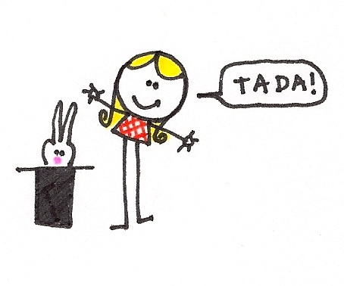
Validate the models on the unseen ratings which were held out
Validate predictor on unseen data
Each student builds models of other students
Create an air of suspense to see whether the model does indeed generalize on unseen data

Slide 24

Data consent
Explain importance of anonymity and privacy of data
Get them to participate in providing consent to share their ratings

Slide 25

Crowd source mentors

Slide 26
Some design choices

Slide 27
Some design choices
Picking a problem statement

Slide 28



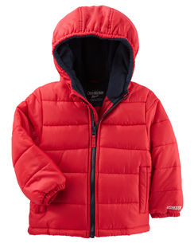

Picking a problem statement
Should not be an obvious exercise in prediction
Should not be too unrelatable

Slide 29
Some design choices
Data collection

Slide 30

Data collection
No to pre-built datasets
Engage students by getting them to upload/play around with the data

Slide 31
Some design choices
Features

Slide 32
Features
Not more than 2-3 features: It gets harder to demonstrate their interaction for anything more
Discrete features: easy to understand and intuitive to handle at the modeling stage

Slide 33
Some design choices
Output

Slide 34
Output
Discrete output: easy to understand and intuitive to handle at the modeling stage
Binary output: easy to understand and visualize

Slide 35
Some design choices
Balanced datasets (inputs)

Slide 36
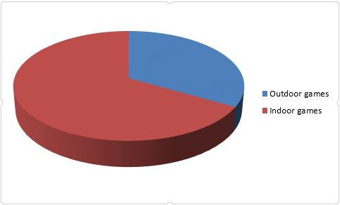
Balanced datasets
(important)
Look at both classes: Importance of looking at the Friend class and the Not Friend class both

Slide 37
Some design choices
Simple arithmetic, easy tech

Slide 38
Simple arithmetic, easy tech
Doesn’t require anything more than addition, multiplication, division and taking ratios/percentages
The tool to implement this idea is any commonly available spreadsheet software. Very flat learning curve
Can always go manual if formulas are not comprehensible

Slide 39
Did students enjoy and learn?
Conducted this tutorial in 4 cities so far – New Delhi, Pune, Bangalore, UC (Illinois)
Each cohort had ~18 students in the age group of 10-15 (median age: 13)
Each session was 3 hours long
Each of them was given a survey at the end of the tutorial

Slide 40
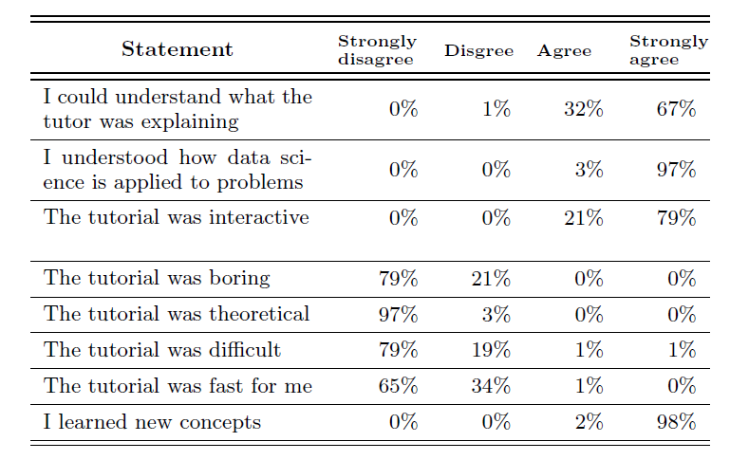
Did the students enjoy and learn?

Slide 41
Did the students enjoy and learn?
Student prompts
Want to monitor my pocket money and expenses
Want to figure out where a criminal resides by clustering the areas of crime
One of them developed the intuition for overfitting and underfitting while at the tutorial and raised questions about splitting train and test sets

Slide 42
Did the students enjoy and learn?
Features that were brainstormed
Artsy vs. Non-artsy hobbies
Happy vs. Grumpy looking faces
“Weird” vs. “Common” name
Hobbies involving hand held tools vs. otherwise

Slide 43
Future work
Reduce TAs
A Scratch equivalent for DS

Slide 44
Key learning
It is possible to pick up data science and provide a higher level intuition to a young audience without boring them
Design choices have to be made carefully to ensure students are not burdened with too many new concepts in one session
Easy to implement and involves a sizeable do-it-yourself component

Slide 45
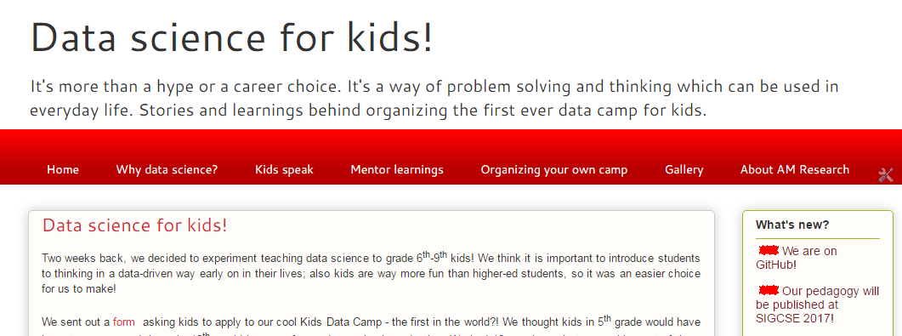
datasciencekids.org
All our material is on it for you to replicate
We’re also on GitHub now

Slide 46





Research at Aspiring Minds
CoDS 2016
Release AMEO-2016, public dataset on employability outcomes, based on AMCAT data
Define product vision. Research and develop prototypes which demonstrate application of state of the art computer science technology in assessment products
Publish at the very best conferences and venues
Multiple outreach programs to popularize data science and machine learning
Data science for kids
ML-India
ASSESS – Annual workshop on data science for assessments
AMEO 2015
ACL 2015
Work on machine learning and crowdsourcing in speech evaluation
ICML 2015
Work on learning models for job selection
KDD 2014
Work on using machine learning in programming evaluation
NIPS 2013
Framework for using machine learning in assessments

Slide 48

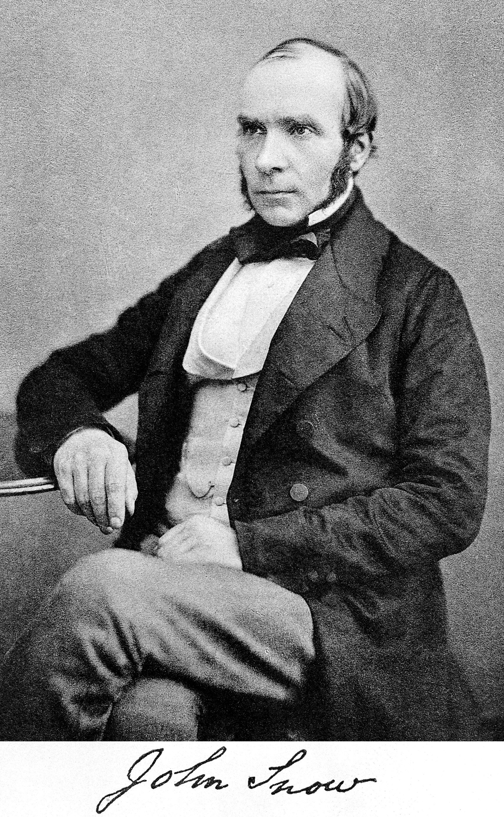
Introduce the broader idea through an example

